Slide 1
Gender, Agricultural Production and the Theory of the Household
Chris Udry
JPE 1996

Slide 2
Growing recognition that unitary hh model is unrealistic
This suggests need for models with interaction between individuals in hh
Cooperative bargaining models especially prominent . These models assume that allocation of resources is Pareto efficient. Some go further as to propose specific sharing rules etc.
But Coop game conclusions not necessarily valid. Non-cooperative bargaining models exist and there is anecdotal evidence of non-Pareto efficiency such as pervasive domestic violence

Slide 3
But the Pareto Efficiency (P-E) assumption is still commonly advocated
Since relationships long-term with good information about each other
P-E proven to be a fruitful assumption in examining outcomes
Browning and Chiappori use Canadian data in demand functions, reject unitary hh model but cannot reject P-E
Thomas and Chen (1994) do the same with Taiwanese data
SSA ,and Burkina Faso in particular, provide good environment for testing P-E within hh since agricultural production is carried out on many different plots controlled by different HH members

Slide 4
Model
HH with 2 members , K private goods , public goods consumed Z
Aggregate consumption of these private goods
C=C_{F} +C_{M}
Labor Supply of individual j is N_{j}
U_{j} (C_{F} ,C_{M,} Z, N_{F}, N_{M})
Plots i with Area Ai and Crop K

Slide 5
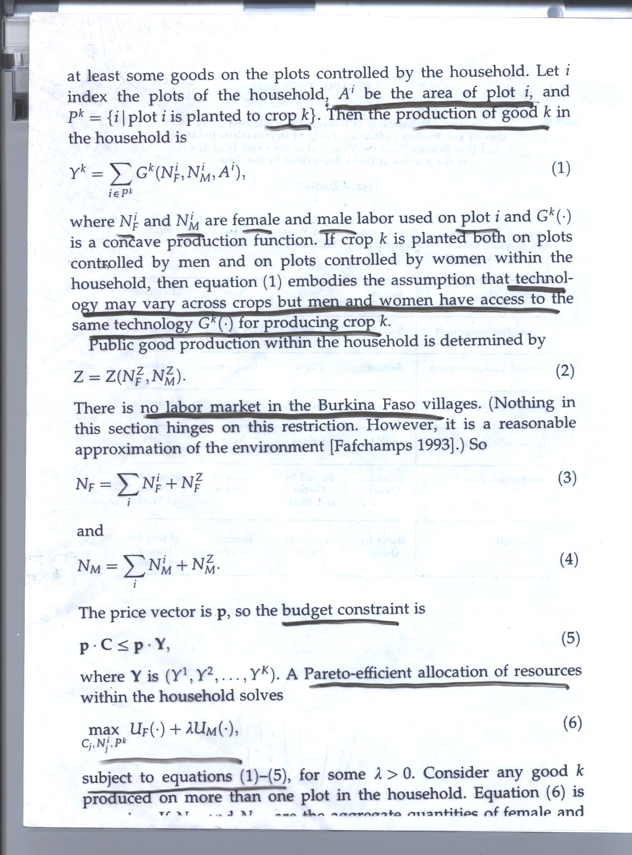

Slide 6
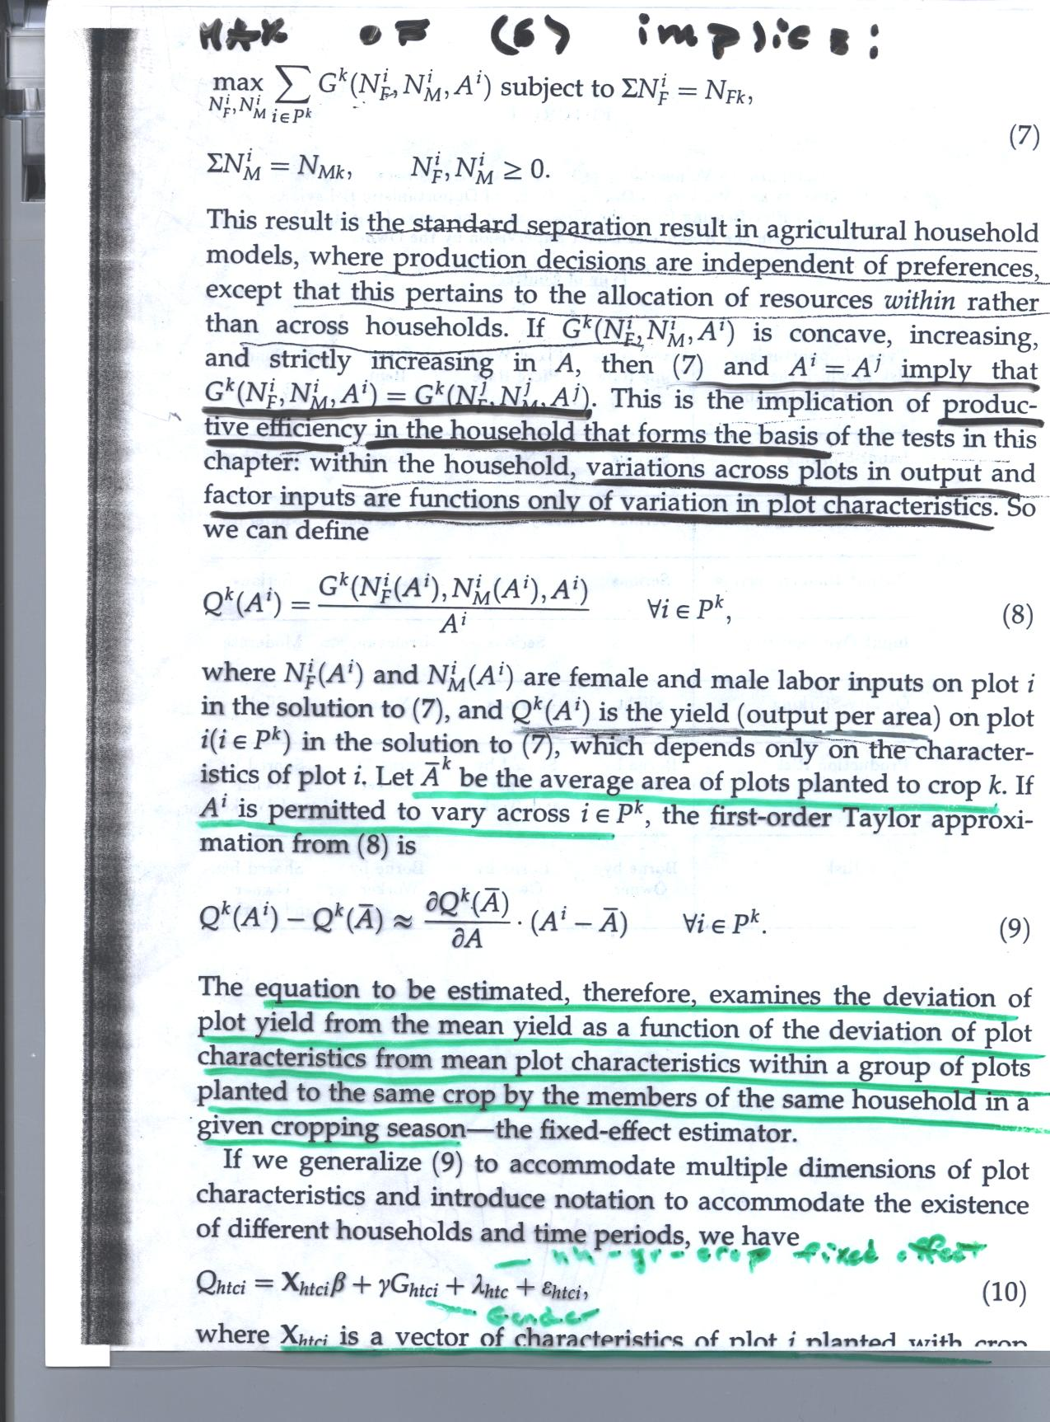

Slide 7
Implication
The coefficient of Gender γ in (10) from Pareto efficiency in (8), (9) should be =0
Q_{htci} = X_{htci}β+γG_{htci} +λ_{htci} + ε_{htci (10)}

Slide 8
Data
ICRISAT Panel in Burkina Faso 1981-5 150 hh in 6 villages in different agro-climatic zones .
This study uses only 1981-3 because of better agroeconomic data. Sample hhs visited every 10 days during these seasons to collect info on each of the hh’s plots 4655 plots .
Same crop often grown on different plots governed by different individuals , multiple wives common. Definition of hh from hh head

Slide 9
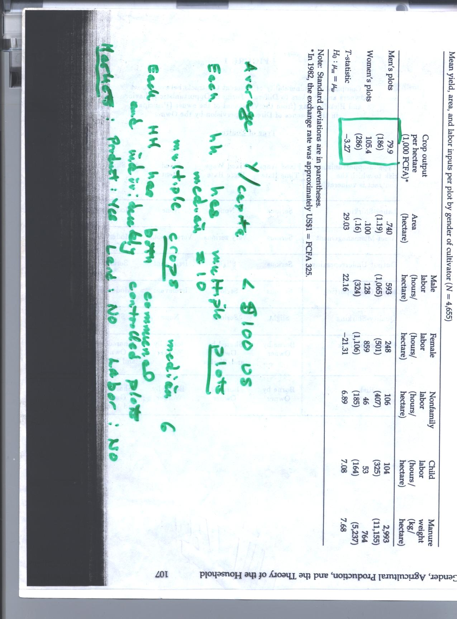
Note the specialization by gender and plot size differences by gender of ownership

Slide 10
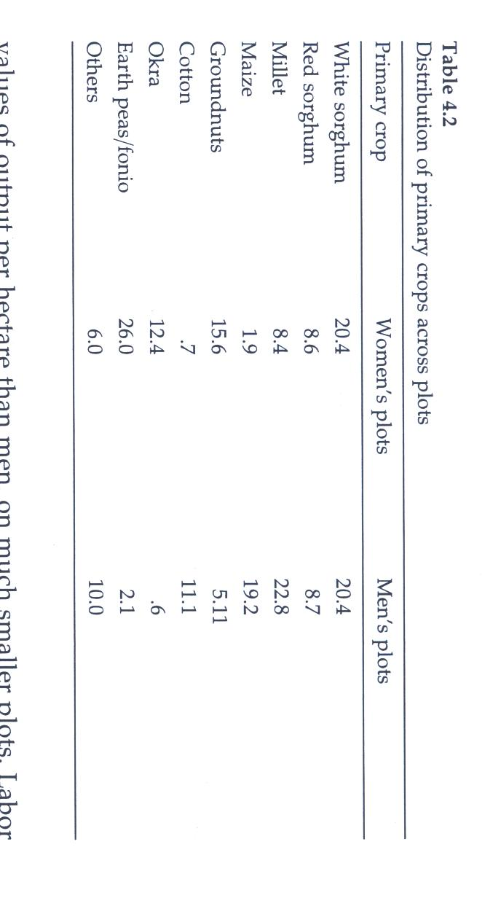

Slide 11
Try to account for sources of productivity differences
Land quality with soil types, location, topography
Crop choice gender specific
Variations in shadow prices of different factors across hhs
Absence of credit may affect not only variations in factors across
hhs but also within hhs
Estimates of (10) focus on yield variations for the same crop on different gender-owned plots

Slide 12
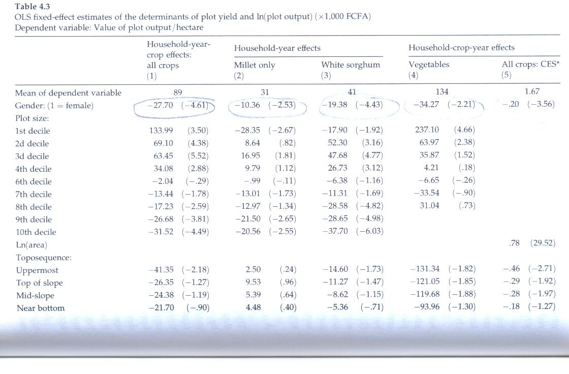

Slide 13
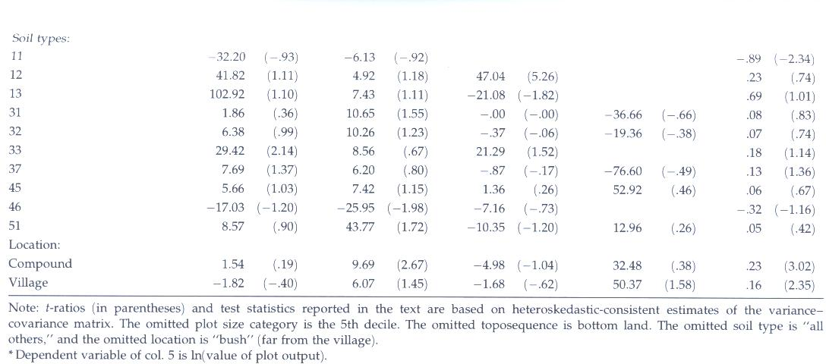
(1) All (2) Millet (3) White Sorghum (4) Veggies (5) All Crops

Slide 14
Comment on results
Yields on female plots 30+% lower than on male plots for same crop and hh which is inconsistent with P-E
This remains even when keeping the same primary crop and secondary crop
But since with very limited markets for land and labor, there are also very sizable differences across hhs
Fig 1 shows that kernel densities lower (variation greater) across individuals in different hhs than within hhs.
Bottom part of Table 3 shows plot and soil characteristics to be significant
Table 4 (not shown here) show cross tab correlations between soil type and crop choice

Slide 15
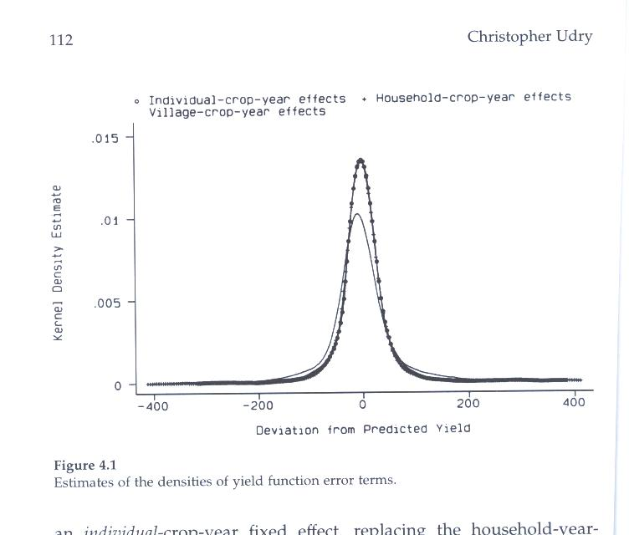

Slide 16
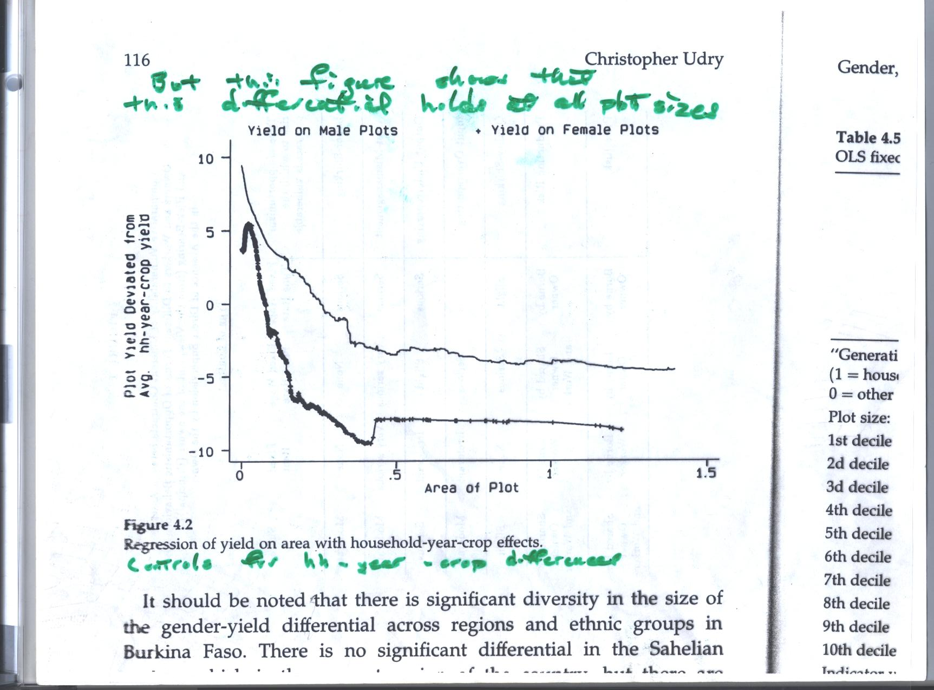

Slide 17
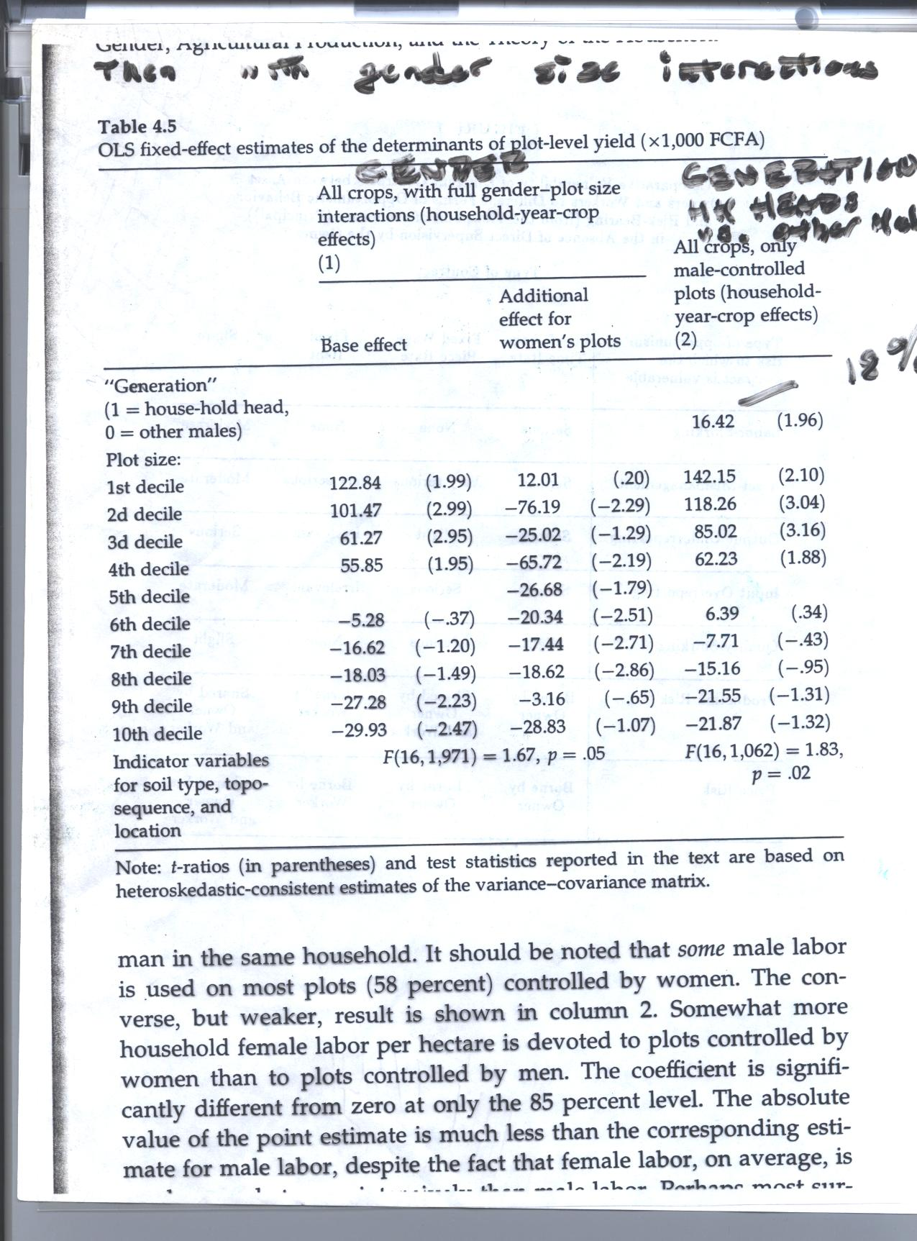

Slide 18
Col. (2) of Table 4.6 shows that there are also intrahousehold yield differences across generations , just different males compared: heads and sons. Gap about 18% in this case
The magnitudes of the gaps varied by region, and ethnic group, being nil only in Sahel, the poorest region. And Rimabe group who live mainly in Sahel but strong differentials among Mossi, Fulse and Bwa groups.

Slide 19
Table 6
This table tries to identify different input intensities on the female and male controlled plots
While inputs of female labor are greater on female owned plots, those of male lsbor, child labor, non-household labor and manure are all lower. Indeed almost all fertilizer is applied to male plots
Reallocations would increase hh income.

Slide 20
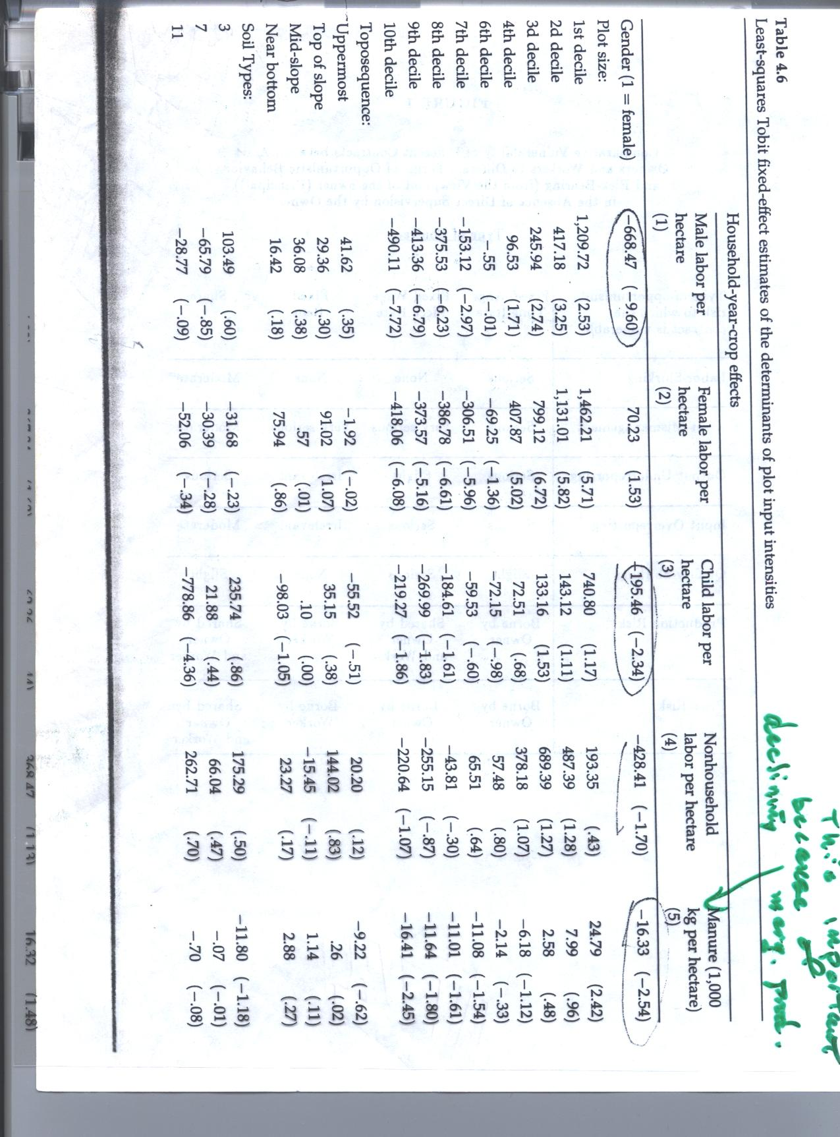

Slide 21
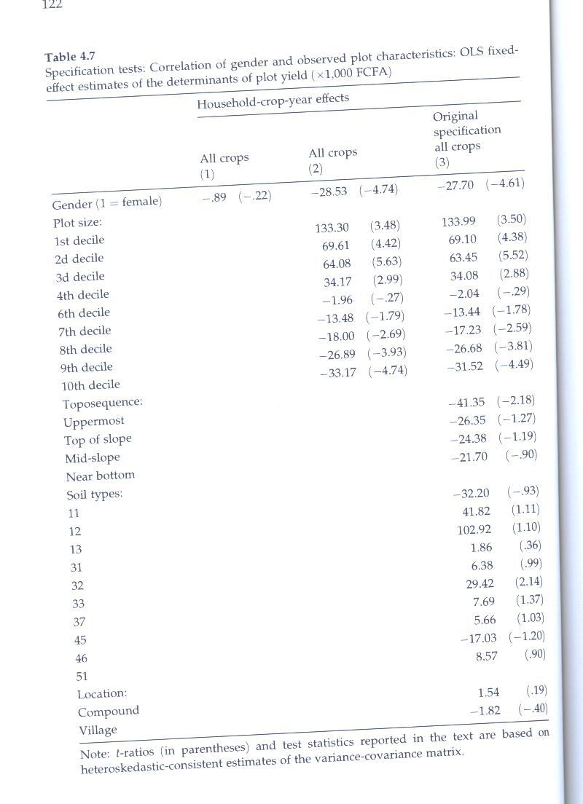

Slide 22
Table 7
Col (1) shows that when all soil and plot characteristics are omitted we see no gender-yield differences
(col (2) controls for plot size and the gap is restored and this not affected when controlling for the full set of characteristics
While not impossible that the gap could be accounted for by unobserved characteristics, this makes it highly unlikely.

Slide 23
Could the gap be attributed to child care responsibilities of women (N_{Z}^{F})?
But note lower inputs of children on female plots
Also no relation between yields and demographic structure of HH
Distance to plots (travel time)could be another factor and could discourage inputs, especially of labor
Table 4.8 but gap does not show decline in those plots that are close to home

Slide 24
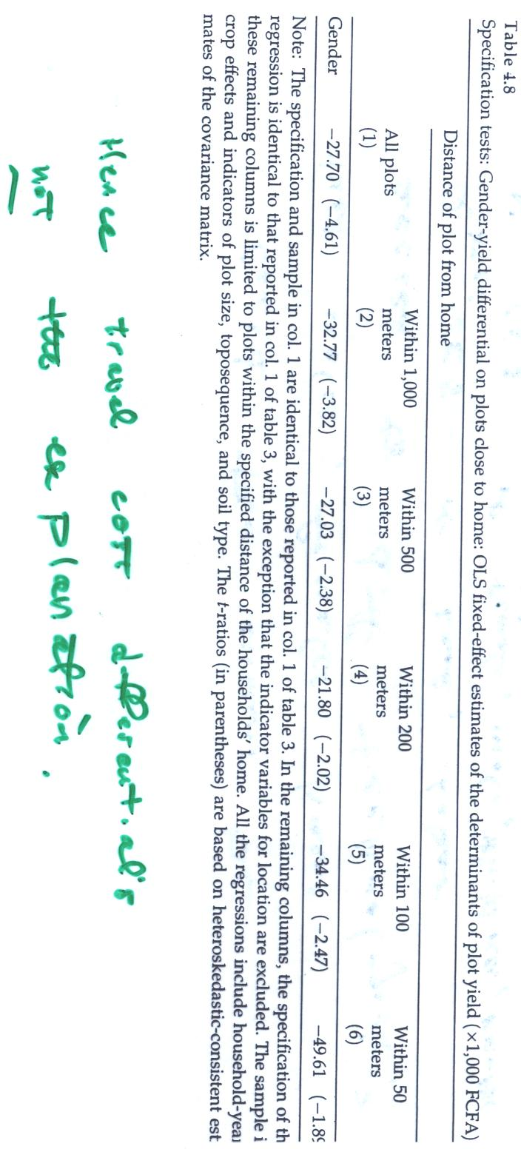

Slide 25
What about the use of more complex production functions CES?
Would production functions be different for different individuals
Cannot reject hypothesis that technology is identical across plots controlled by men and women based on the insignificant interaction effects in Table 9

Slide 26
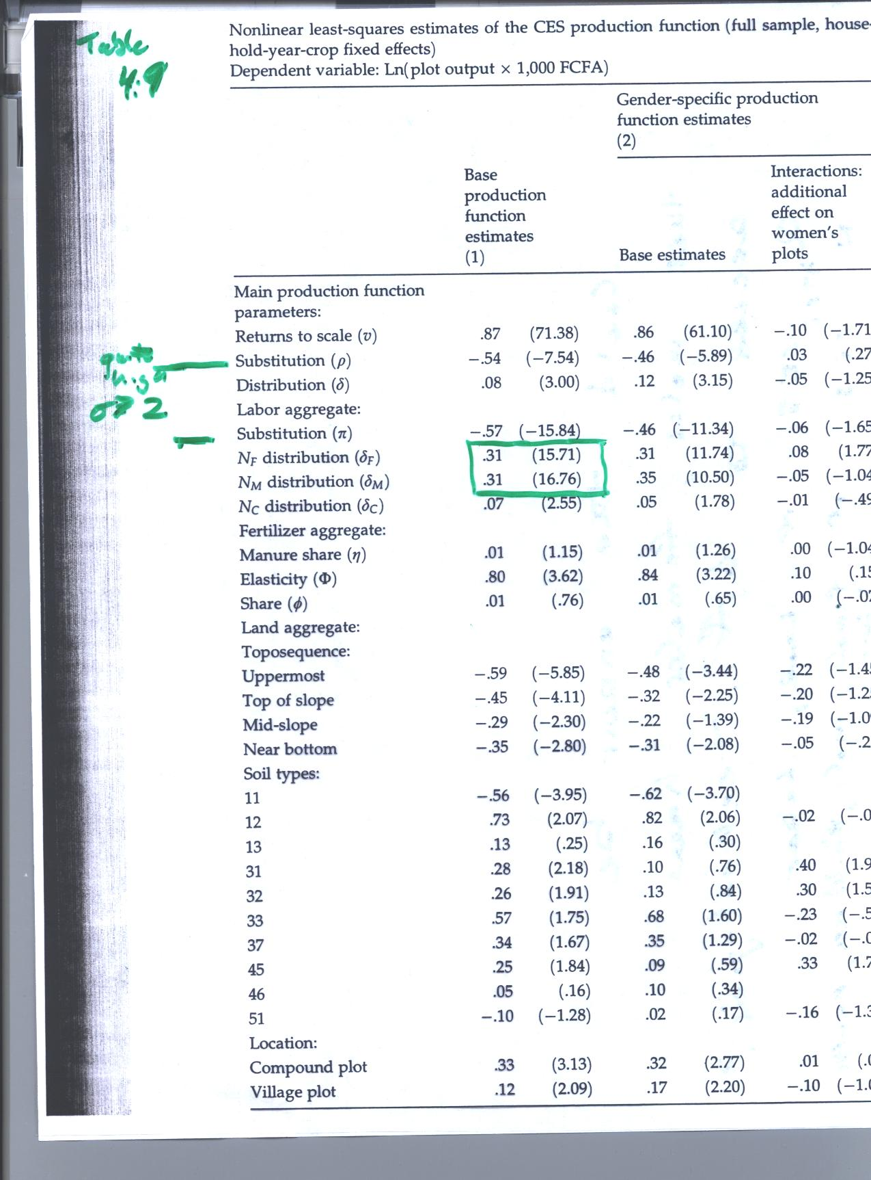

Slide 27
Conclusions
The results would appear to show that the allocation of resources within sampled Burkina Faso households is not Pareto efficient and hence that neither unitary household or cooperative bargaining models are appropriate
Individual plots are controlled by different individuals .
The allocation seems to result from marriage arrangements. If money was used as the asset transferred overall efficiency might rise. But there is no asset like this.
Absence of land and labor markets. Land market blocked by lack of tenure security. One has to use the plots to be able to keep them. But security greater within hh than between them.
Absence of labor markets said to be due to moral hazard . Fragmentation of plots increases labor monitoring costs.

Slide 28
Comments
But are share and piece rate contracts really inefficient?
A rental possibilities within the hh ruled out by insecurity of tenure?
Is violence within the household due to disputes over what constitutes sufficient compensation for woman working on her husband’s plot?
Is the smaller degree of variance in yields across individuals in the same hh than in different hhs due to greater altruism and production of public goods

